Slide 1






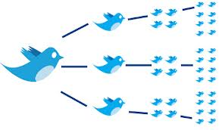

USER GENERATED CONTENT ANALYTICS Network Analytics October 30, 2018
Dr. Anitesh Barua
Email: aniteshb@gmail.com

Slide 2
Network of Stocks
 | s₁ | s₂ | …. | s_{n}
s₁ | 1 | c₁₂ | … | c_{1n}
s₂ |  | 1 | … | c_{2n}
… |  |  | 1…1 | …
s_{n} |  |  |  | 1
Stocks s_{i} and s_{j} (i ≠ j) will have a link (edge) if price correlation |c_{ij} | ≥ threshold.
Many important properties can be studied using network analytics
E.g., which stock is most important in explaining price movements of the group?
Copyright Anitesh Barua 2018

Slide 3
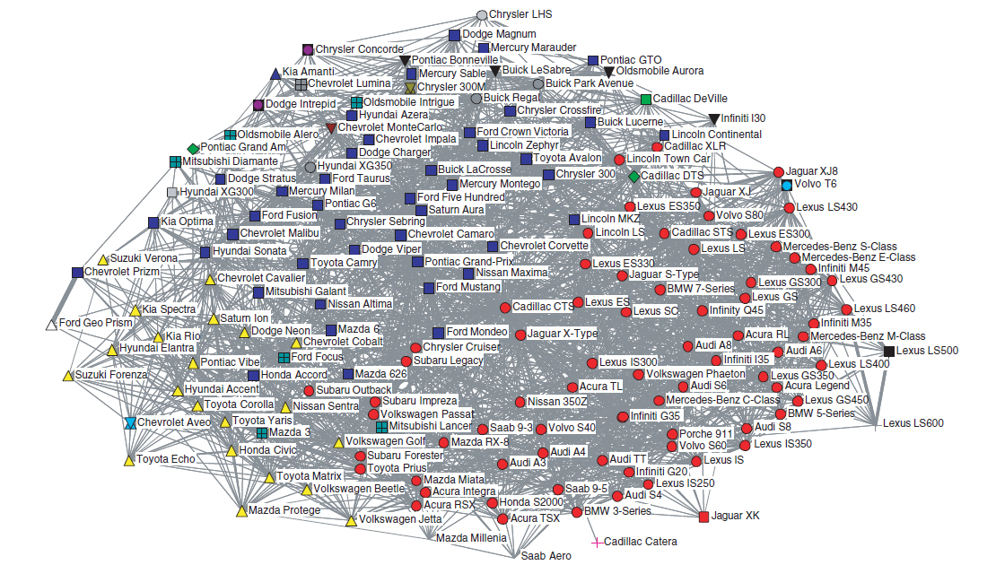
Not just People: Co-mentions of Car Models from Edmunds.com Sedan Forums

Slide 4
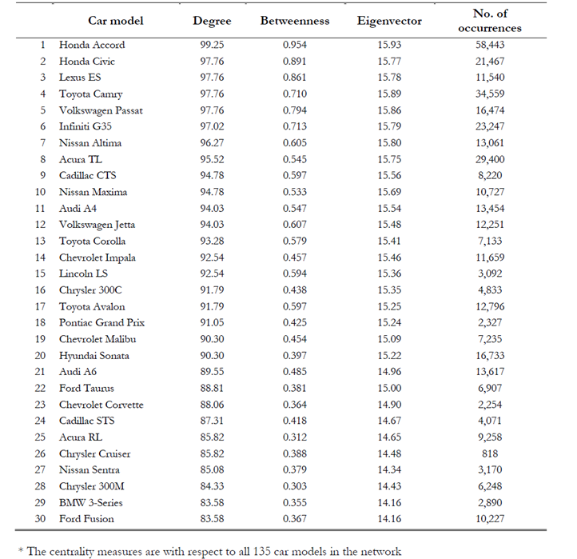

Slide 5
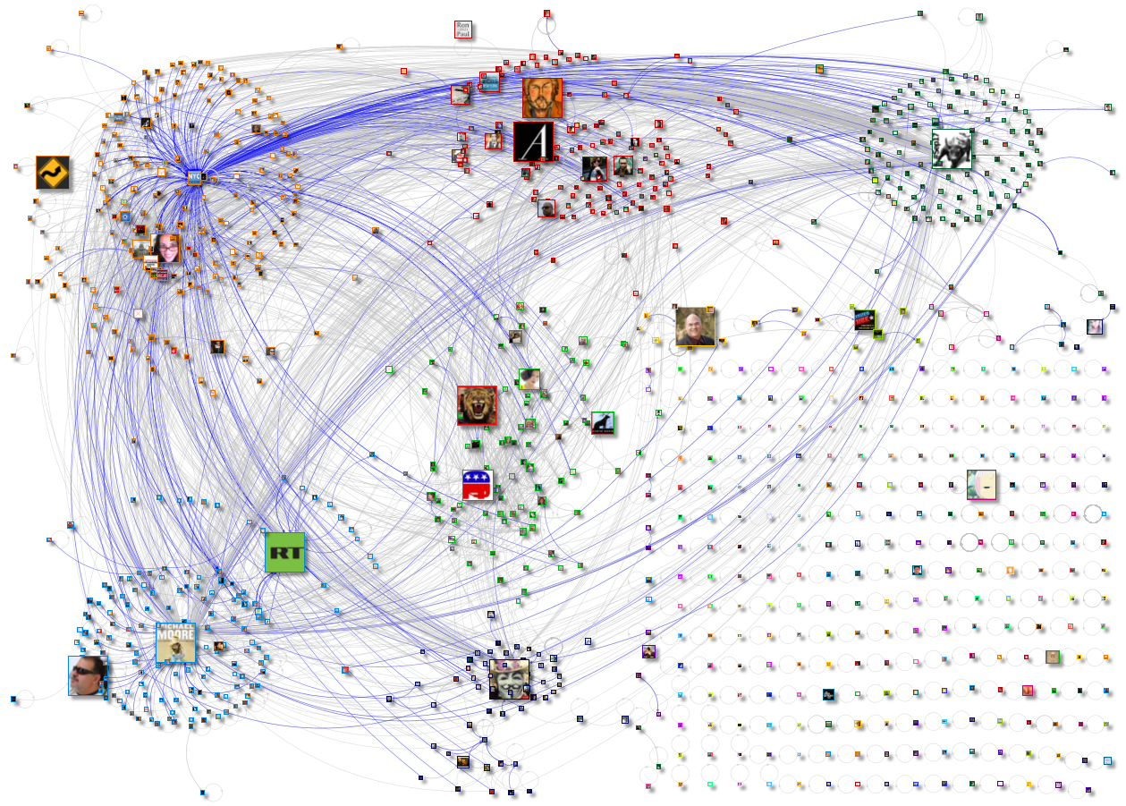
Which Events Gain Momentum: Tea Party or Occupy Wall Street?
Source: www.newscientist.com

Slide 6
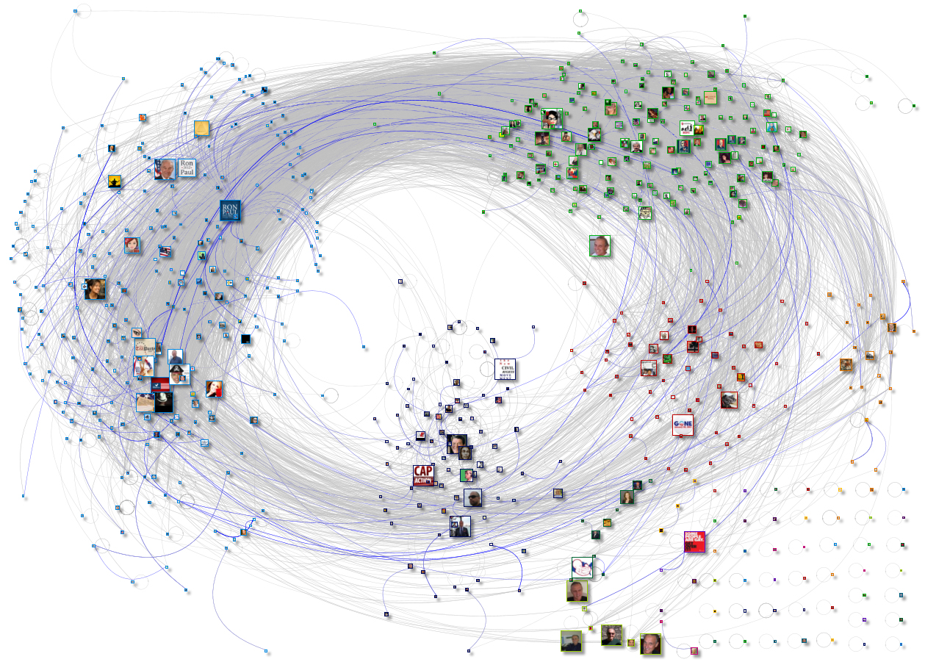
How is This Different From the Previous Network?
Source: www.newscientist.com

Slide 7
Predicting Future Links
“If you are friends with Alan, and friends with Betty, then it is likely that Alan and Betty will become friends as well, mostly because they already have something in common: You.”
“You brought a friend to your favorite yoga studio and she started regularly attending class, even when you didn’t go.”
Source: http://plainspokenlinguist.wordpress.com/2013/09/20/i-know-a-guy-the-power-of-triadic-closure/

Slide 8
Predicting Future Links (Edges) With “Triadic Closure”
G
G
B
C
B
C
F
A
F
A
E
D
E
D
“If two people in a social network have a
common friend, then there is an increased
likelihood that they will become friends
themselves at some point in the future”
“People you may know” in FB
G
B
C
F
A
Clustering coefficient of a user: Probability
that two randomly selected friends of a user are
friends with each other.
E
D
Source: Easley & Kleinberg, “Networks Crowds & Markets”

Slide 9
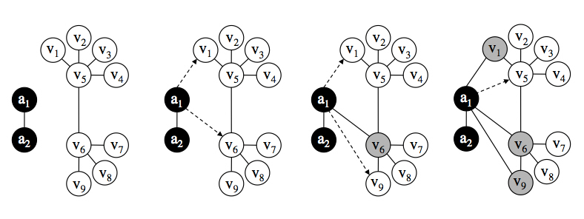
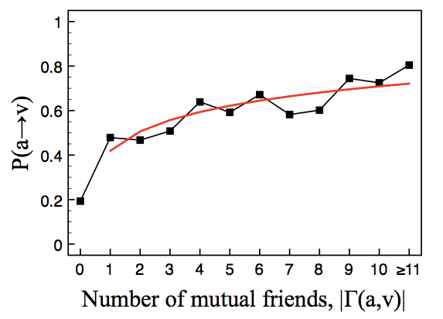
Abusing the Triadic Closure Principle
UBC students wrote a program that randomly sent friend requests
If accepted, target their friends based on triadic closure
Fake
profiles
N(a,v)
Source: http://blogs.cornell.edu/info2040/2011/09/30/abusing-triadic-closure/

Slide 10
Evolution of Social & Affiliation Networks
Membership closure
Person
Activity, interest or group
Person
Focal closure
Triadic closure
Source: Easley & Kleinberg, “Networks Crowds & Markets”

Slide 11
Predicting Closures
Claire
Anna
Music group
Bob
Dan
Volunteering
Source: Easley & Kleinberg, “Networks Crowds & Markets”

